Slide 2


Slide 4
Lowering the Barriers to Entry for Continuous Integration in LabVIEW
Allen C. Smith, CLA
Senior Systems Engineer
Brandyn Adderley, CLA
ATE Supervisor

Slide 5

Is this presentation for you?
You work on medium to large projects
Multiple developers work on the same project
You perform unit testing
Your builds (exe, llb, etc) take a long time or
You need to build often
You want to automate your functional testing

Slide 6
Overview
What is Continuous Integration
Project Goals
Definitions
Work Flow
Tool Support
LabVIEW Web Service
Adding New Job Types (Extending Capability)
Alfred
Road Map

Slide 7
What is Continuous Integration?
Definition: Continuous Integration (CI) is a development practice that requires developers to integrate code into a shared repository several times a day. Each check-in is then verified by an automated build, allowing teams to detect problems early.
Possible Components:
Frequent commits to source code control
Unit Testing
Compiling (llb, exe, VI package, etc)
Functional Testing

Slide 8


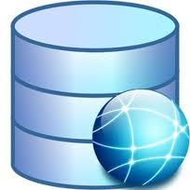




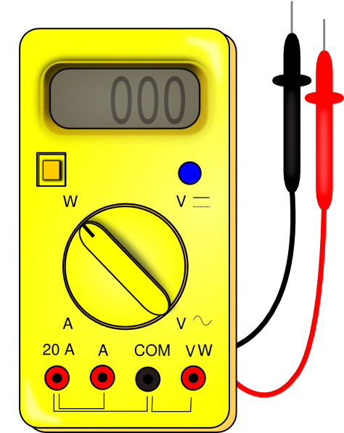

What is Continuous Integration?
Unit Testing
Developers
Source Control
Build
CI Tool
Functional Test
Notes:
Add graphic for workflow
User commits to SCC
CI Tools sees commit
CI Tool kicks off test, build etc

Slide 9

Benefits of Continuous Integration
Unit Testing & Functional Testing
Find Bugs Sooner
Reduce Debugging Time
Automate the Testing
Reduce Validation Cycle
Building the Package
Automate & offload the build process
Development can continue while current changes are built
Build across LabVIEW versions
Lowers burden for improving “legacy” code
Notes:
Need better picture?

Slide 10
Barriers to Entry
Another tool to learn
Installation and configuration
Not specifically designed for G environments
No direct integration with LabVIEW
No LabVIEW plug-in
Batch implementation solutions are inflexible and fragile
No LabVIEW API
Users must manually configure their CI provider for each project
Notes:
****Visible for Alliance Day, hidden for NI Week****

Slide 11
Project Goal
Lower the bar for LabVIEW developers to use Continuous Integration
Better Build Tools
Better Setup Experience
Better way to interact with the CI Provider
Better Error handling
The problem is divided into two parts:
Invoking LabVIEW operations from the CI Provider
Configuring the CI Provider

Slide 12




Continuous Integration Tools
Apache Continuum
CruiseControl
Hudson
Jenkins
Travis CI
And many more…

Slide 13
Implementing CI with Jenkins
Automate build & test process with Jenkins
Feature Highlights:
Open Source
Web-Based GUI
Simple Job Configuration
Multiple Build Executors
Extensible through plug-ins

Slide 14
Definitions
Jenkins Job – The basic unit of work in Jenkins. This is also known as a project
Workspace – The working directory for a Jenkins job.
Source Code Poll – Jenkins has the ability to poll Source code control for events such as Commits.
Artifacts – Files that are generated and associated with a specific build
Executor – a thread a single job can run in. If you want to run parallel builds, then you need to have multiple executors or multiple nodes.
CI Project – a collection of Jenkins jobs

Slide 15
Invoking LabVIEW from Jenkins

Slide 16
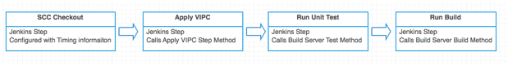

Jenkins Workflow
Notes:
Every step in the build process is a job in Jenkins. So a CI Project is a collection of these jobs.
Each Jenkins job is configured with the information needed to complete the build step. For example, an SCC checkout step contains information about the source code control provider and the repository to extract. When the job executes, Jenkins passes this data to the SCC provider, which completes the operation.

Slide 17
LabVIEW Build Workflow
Clean Workspace
Perform [Action]
[Action] Copy Files to Workspace
Workspace Files are archived with build
Notes:
The CI Service invokes code in the development environment to perform the build and related housekeeping steps. These steps include making build artifacts available to Jenkins for archive.

Slide 18
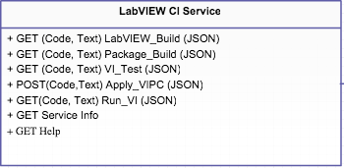

Jenkins – LabVIEW Interaction
HTTP
Notes:
Jenkins interacts with LabVIEW via the LabVIEW CI Service, a web service built in LabVIEW. To execute a LabVIEW build, for example, Jenkins invokes the LabVIEW Build method of the service. Jenkins passes the step configuration data to the service as a JSON string.
The LabVIEW CI Service uses this data to initiate a LabVIEW build.
Even though builds can only be performed in the LabVIEW development environment, the LabVIEW CI Service is an executable. To avoid cross-linking issues, we want to be able to shut down the development environment between builds; Jenkins, however, expects a continuously available web service. The LabVIEW CI Service, therefore, manages a LabVIEW development environment to complete its tasks.

Slide 19

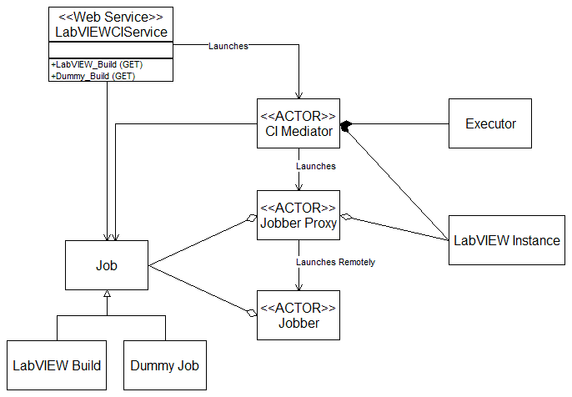
LabVIEW CI Web Service
Jenkins
Notes:
This class diagram displays the structure of the LabVIEW CI Service. JSON data from Jenkins is converted into Job class, which is passed down to a Jobber actor. The Jobber executes the Job.
The Service is built with Actor Framework. No knowledge of AF is required to work with the Service.

Slide 20
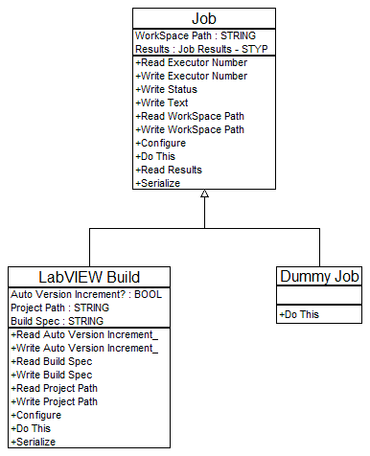
The Job
Notes:
A Job is a LabVIEW class that encapsulates a set of operations to be performed in the LabVIEW development environment. The LabVIEW Build job, for example, performs builds.
All Jobs have a Do This vi, which does most of the work. The objective of the CI Service is to move data from a Jenkins job to the Do This VI of a Job class.
To give you some background, let’s look at how this happens.

Slide 21
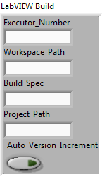
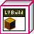

Job Sequence
LabVIEW CI Web Service
CI Mediator
Jobber Proxy
PFM
(Pure Freakin’ Magic)
CI Service Executable
Jobber
LabVIEW Development Environment
Notes:
The Jobber Proxy uses Launch Remote Actor to manage actors across the application boundary.

Slide 22
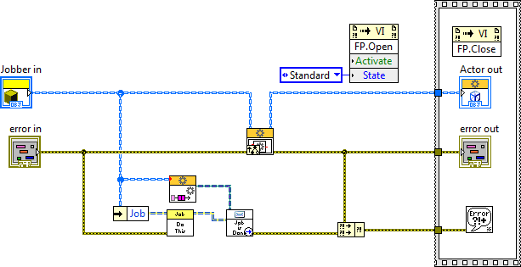
Jobber: Actor Core
Notes:
The Jobber executes the Job as soon as it is launched, and shuts down as soon as the Job is complete.

Slide 23
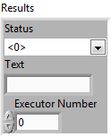
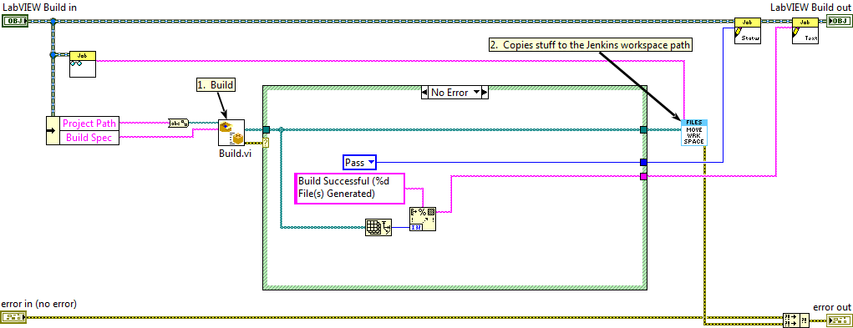
The Job: Do This.vi
Notes:
This is the Do This VI for the current incarnation of the LabVIEW Build job. We simply invoke the NI App Builder Build VI.

Slide 24
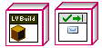
Job Sequence
LabVIEW CI Web Service
CI Mediator
Jobber Proxy
CI Service Executable
Jobber
LabVIEW Development Environment
Notes:
TODO: needs the line

Slide 25
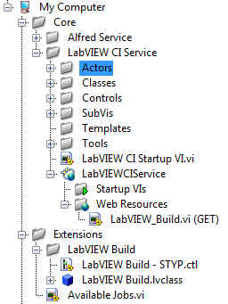
Extending Capability (New Job Types)

Slide 26
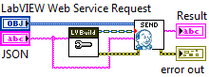
New Job Types
Configure.vi

Slide 27
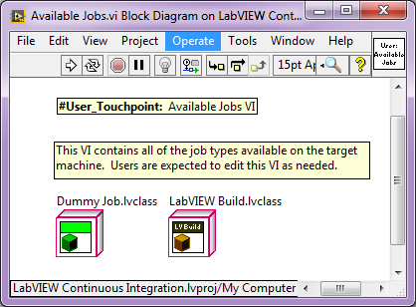
New Job Type

Slide 28
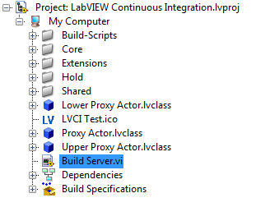
New Job Types
Call this VI to build the CI Server
Notes:
The last step is to rebuild the CI server. We give you a VI to do that.

Slide 29
Configuring Jenkins

Slide 30


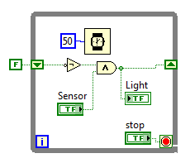
The User Experience
Build Server with:
Jenkins
CI Service
LabVIEW (for builds)
Development Systems:
CI Project Builder
LabVIEW (for development)

Slide 31
Remember….
Job configuration passed in a URL
Notes:
Jenkins passes the job configuration to the CI Service in a JSON string.

Slide 32
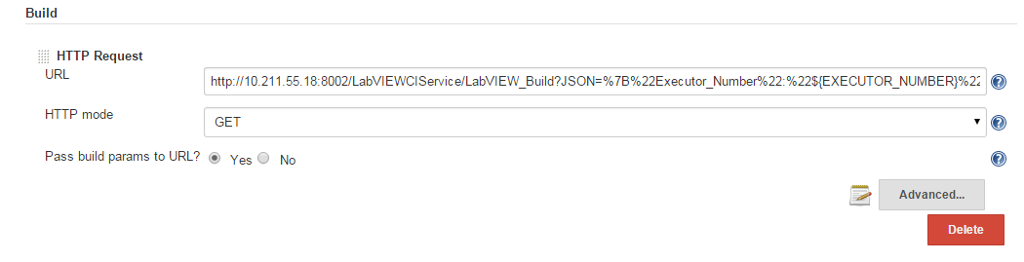
Passing Information
Notes:
We use URLs to invoke web services. If the service requires data, that data is included in the URL. Our data is encoded in a JSON string.
So how do we populate the URL field?

Slide 33
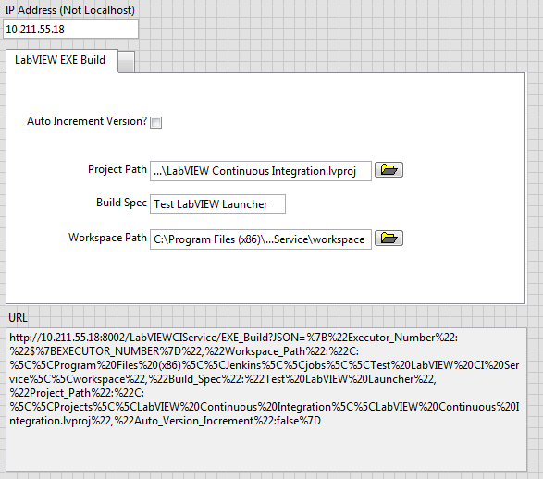
Passing Information
Notes:
This is an early tool we wrote to generate our URLs. As you can see, the JSON string is long and complicated. Building it by hand, or even using this kind of tool, would be tedious and error-prone.
Our goal is to make the process is straightforward as possible, so…

Slide 34

Alfred
Notes:
… we’re working on a tool, called Alfred, to allow you to easily configure your Jenkins jobs.

Slide 35
What is Alfred?
Officially it’s the “LabVIEW CI Project Builder”
Set of Build Scripts in Jenkins
LabVIEW API
LabVIEW based Build Tool
Build Tool
Create Jenkins Jobs
Save Configuration
Load Past Configurations
Built using the Configuration Editor Framework
https://decibel.ni.com/content/docs/DOC-37225
Notes:
It’s not officially called Alfred, of course. That would put us somewhere near the top of Batman’s list, a place no one wants to be.
Alfred addresses the second part of the problem, which is configuring the Jenkins Job from the LabVIEW IDE.

Slide 36
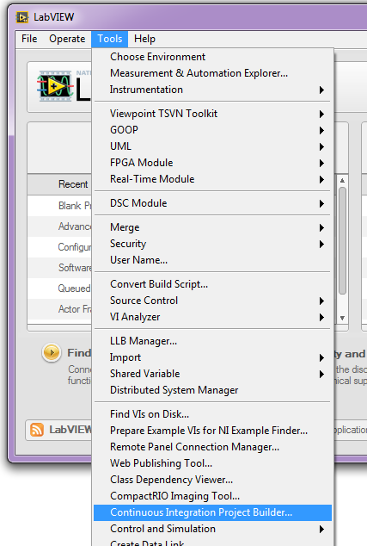
LabVIEW CI Project Builder
Script Jenkins Jobs (from LabVIEW)
Creates Folder for jobs
Creates Jobs for every step
Setup URL of CI Web Service
Chains jobs together
Set up Email Notification
Setup Days to artifact
Setup SCC Polling Schedule
Setup Build Trigger Schedule
Create Job Initialize Step
Notes:
At present, you launch Alfred from the LabVIEW or Project Tools menu.

Slide 37
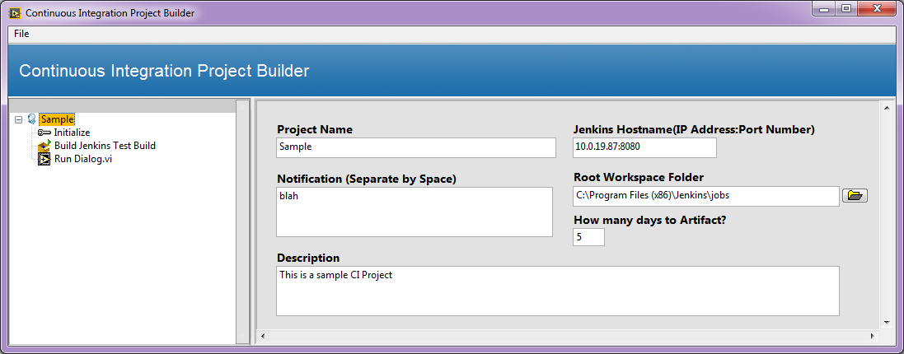
LabVIEW CI Project Builder
Notes:
Here it is, with a sample build job loaded.

Slide 38
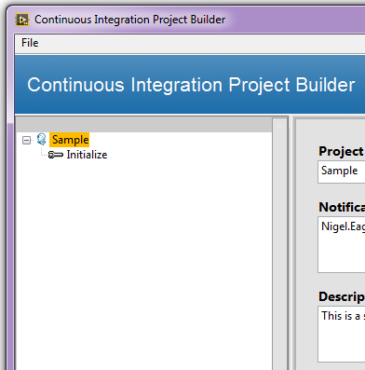
LabVIEW CI Project Builder
Notes:
Initially, the configuration just includes the CI project (called Sample in this case) and the Initialize job. You always have these two elements, and they cannot be deleted.

Slide 39
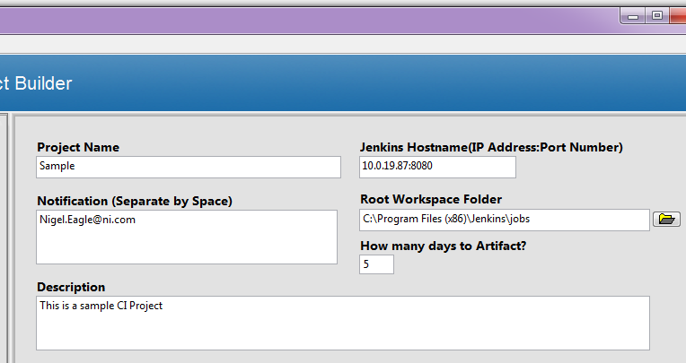
LabVIEW CI Project Builder
Pro Tip: This is the path to a folder on the CI Server
Notes:
The CI project defines a few global settings, such as where Jenkins is located, how many days to keep artifacts, and who gets notified if the build fails.

Slide 40
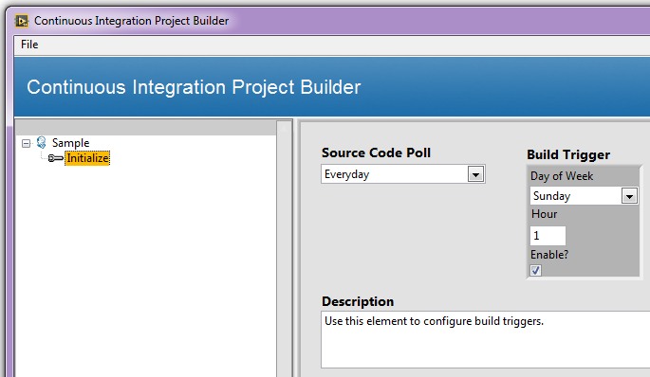
LabVIEW CI Project Builder
Notes:
The Initialize step defines how often you will poll source code and kick off a build.

Slide 41
LabVIEW CI Project Builder
Job Initialize is a single touch point for users to:
Configure SCC pulls TODO point out that this in Jenkin
Start the Build
Job Initialize
Build Step 1
Build Step 2
Notes:
Every distinct action in your CI project is a job. The first job is Initialize. Assuming it is successful, it will trigger the next job to be performed.
In some ways, Job Initialize is a shell. You will modify this job in Jenkins with details on your source code control system, so that it can pull the latest version when you want to start a build.

Slide 42
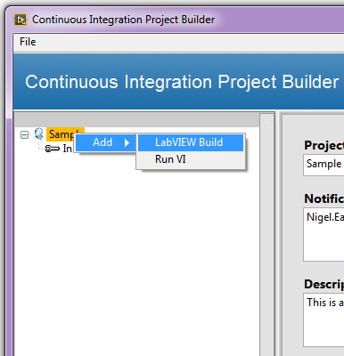
LabVIEW CI Project Builder
Notes:
You add jobs to your project by right clicking on the CI Project and selecting Add » <New Job>.

Slide 43
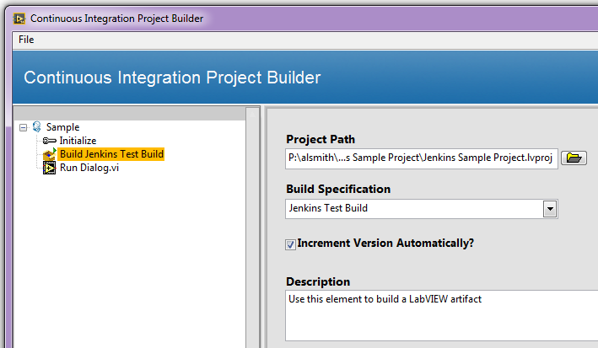
LabVIEW CI Project Builder
Pro Tip: Use the same project paths on your CI Server and development computers
Notes:
We ship the LabVIEW Build and Run VI jobs, corresponding to the two web methods we ship with the CI Server. (The CI Project and Initialize jobs manipulate Jenkins directly.)
The LabVIEW Build job (shown here) needs information about the project path and build specification to be run. Note that the project path is the path to the project *on the build server*, not your local machine. If your local project path matches the one on the CI server, the Build Specification combo box will be populated with a list of available build specifications.

Slide 44
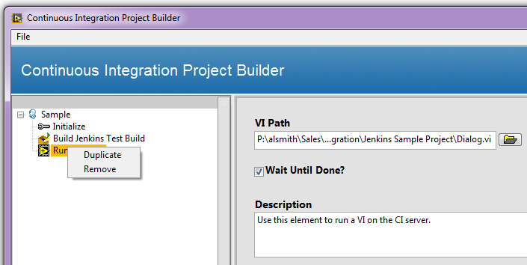
LabVIEW CI Project Builder
Notes:
You can duplicate, remove, or reorder your LabVIEW Build and Run VI steps.

Slide 45
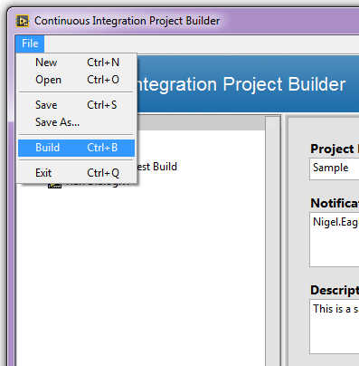
LabVIEW CI Project Builder
Notes:
Simple menu commands allow you to Load, Save, and Build your project.

Slide 46
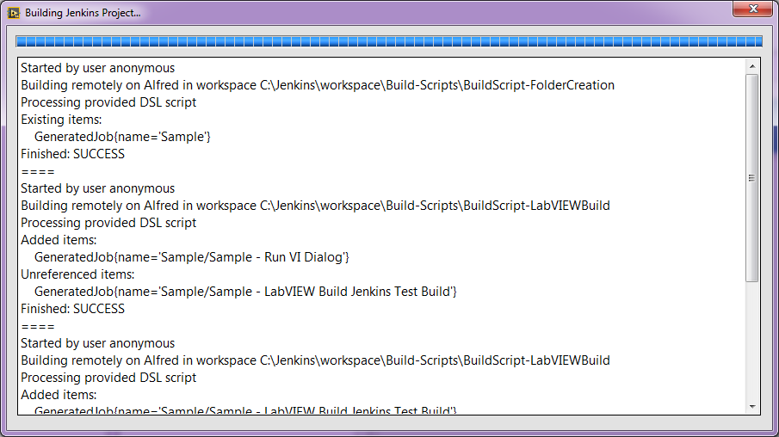
LabVIEW CI Project Builder
Notes:
The build process can take a few moments to complete, so we give you a progress bar.

Slide 47
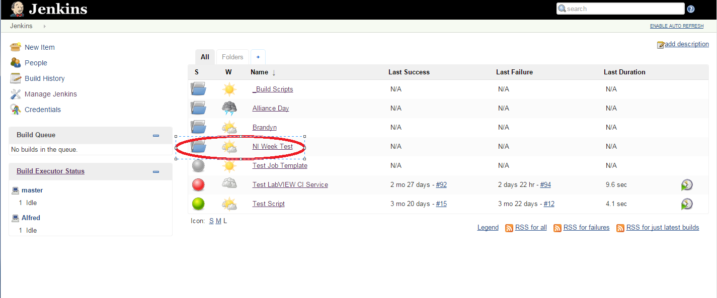
Jenkins

Slide 48
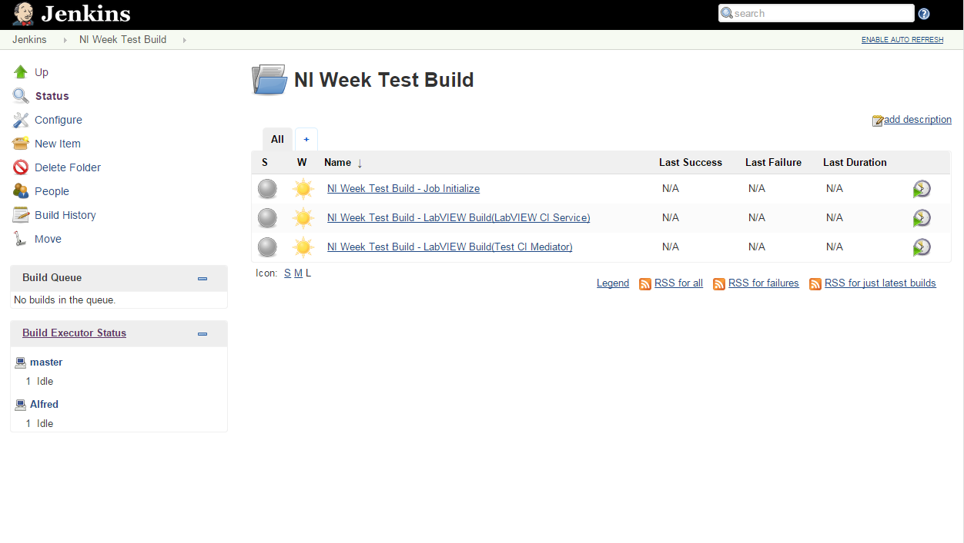
Jenkins

Slide 49
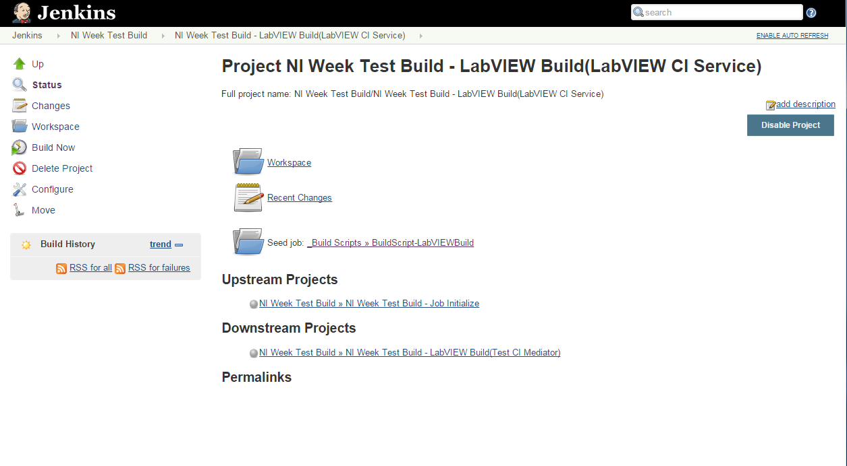
Jenkins

Slide 50

Demo Time

Slide 51
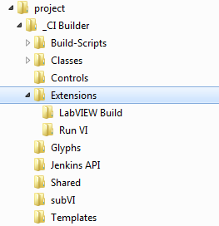
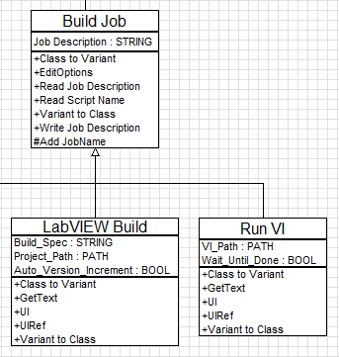
Extending Capability (New Job Types)
Notes:
Like the CI Server, we built Alfred to be user-extensible. The process is actually easier with Alfred.
You add a new job type by creating a child of Build Job, and adding that child to the <LabVIEW>\project\_CI Builder\Extensions folder. Alfred will automatically detect the new job and make it available to add to your CI project.
You need to write five VIs. Four of them are overrides of Build Job methods.

Slide 52
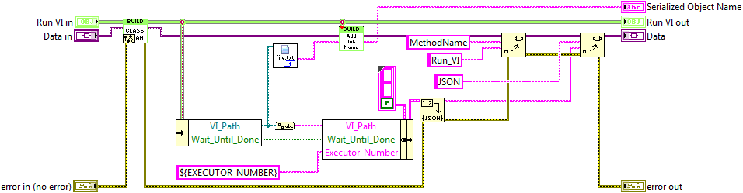
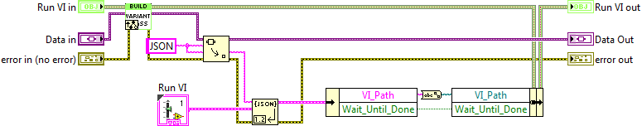
Serialization
Class to Variant.vi
Variant to Class.vi
Notes:
You need to override the two VIs that serialize/deserialize the job data. These VIs are used when writing job data to a file or to Jenkins, or when loading job data from disk.
These VIs make use of a property bag, which is just a variant database, so the process is straightforward.

Slide 53
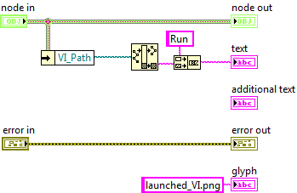
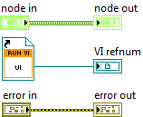
Display Overrides
GetText.vi
UIRef.vi
Notes:
You need to provide overrides for two VIs used by the CEF. One provides display text and an optional display glyph. The other launches the user interface for the job.

Slide 54
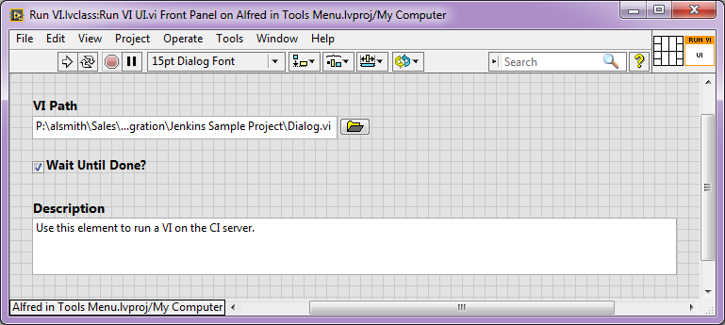
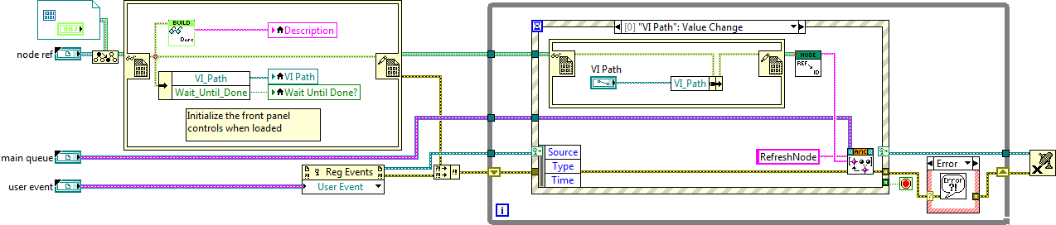
User Interface
Notes:
The job UI is the final VI you must provide. This is the panel that is displayed when you select the job in Alfred. It’s a little fiddly, but we provide a template to get you started.
If you are writing a new job to correspond to a new CI Server method, that’s it. You can write jobs that manipulate Jenkins in some other way, like the CI Project and Initialize jobs; they are a bit more complicated, but follow the same pattern.

Slide 55
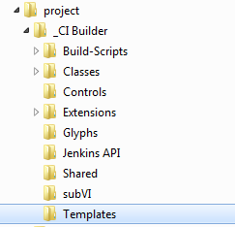
User Interface
Notes:
You can find the template in Alfred’s “Templates” folder.

Slide 56
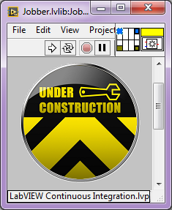
Where Can I Get It?
The LabVIEW Continuous Integration Project:
VI Package for the CI Service
LabVIEW Build extension
Run VI extension
VI Package for Alfred
Documentation
https://decibel.ni.com/content/docs/DOC-46694
Notes:
The CI Service package contains the source code and build specifications required to build a CI Server for your platform.

Slide 57
Updates
https://decibel.ni.com/content/groups/continuous-integration-in-labview

Slide 58
Roadmap
Near-term
Bug fixes
A better installer for the CI Service
Documentation for SCC pulls for some providers
Mid-term
Alfred as Project Provider (new build specification)
VI Tester Extension with JUnit results
VI Analyzer Extension
VI Package Manager Extension
Apply VIPC Extension
Notes:
TODO: Revisit road map with new objectives

Slide 59
Questions?

Slide 60
10 a.m. – 12:45 p.m. Morning Sessions 4th Floor
Rooms 11-19
12:45 p.m. Lunch Keynote/Awards Ceremony Expo Hall 4
2:30 – 5:30 p.m. Afternoon Sessions 4th Floor
Rooms 11-19
5:30 – 7 p.m. NIWeek Welcome Happy Hour/ Expo Hall 3
Exhibition Opens

